Slide 1

Non-parametric tests
Dr Lee Barnby
School of Computing
7MA505 Statistical Techniques
Week 7, Autumn Semester

Slide 2
Outline
Quick review of previous topics
  Assumptions for parametric tests
Non-parametric tests
  Wilcoxon Signed-Rank Test

Slide 3
Statistical Inference
Interpretation of data which is subject to random variation
Two main aims
  Reaching a decision: e.g. which crop variation is better
  Summarise information in the data
Statistical model with data that is assumed to be random
Assume the population follows a normal distribution
  Or another standard distribution, e.g. binomial
Parameters are unknown and hence must be estimated

Slide 4
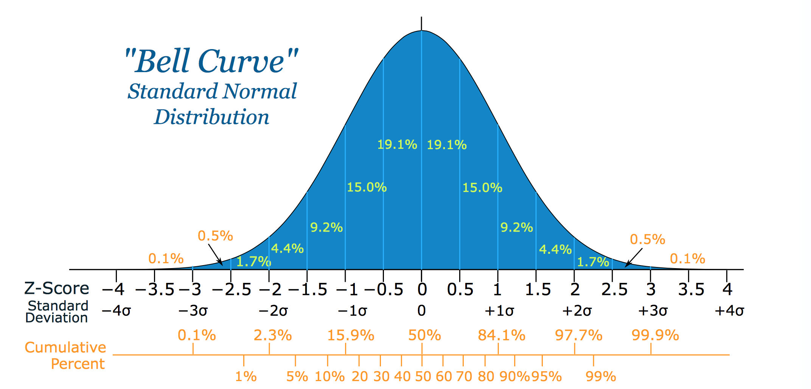
Standard Normal Distribution
Standard because
µ=0, σ=1
https://www.mathsisfun.com/data/standard-normal-distribution.html

Slide 5
Statistical Inference
Statistical inference uses sample data and statistical procedures to
  Estimate an unknown parameter using a sample statistic with a specified level of certainty either point estimates or confidence intervals
  Test a Hypothesis using a sample and making a decision either to support or to reject a statement about a parameter value
Assumptions. Most estimation and hypothesis testing procedures make certain assumptions about the data and sample size.

Slide 6
Statistical Inference cont.
Confidence Intervals: Provide a range of values around an estimate.
  Width of the interval depends on the sample size and sample standard deviation
Hypothesis Tests: Used to look for evidence that a null hypothesis is not true (using a test statistic and p-value)
Measure of uncertainty (error) is attached, such as:
  95% confidence intervals.
  Hypotheses rejected at the 5% significance level

Slide 7
Summary of the Hypothesis Testing Procedure
State aims and hypotheses
Decide on appropriate test and collect sample of data
Summarise data and check assumptions
Compute test statistic and p-value (using a statistical software package)
p > 0.05
  Do not reject H₀
  No evidence that H₀ is not true
p < 0.05
  Reject H₀ at the 5% sig. level
  Evidence that H₀ is not true
0.05 being a typical standard criterion

Slide 8
Hypotheses
Null Hypothesis: e.g. H₀ : μ = μ₀
  Population mean is a given value μ₀
Alternative Hypothesis: H₁ : μ ≠ μ₀
  The population mean is not the given value μ₀
One-sided alternatives:
  H₁ : µ < μ₀
  H₁ : µ > μ₀
Sample size: Larger samples give more accurate results.
Procedure can be reversed: Sample size calculations can be used to decide on appropriate sample size for a desired accuracy

Slide 9
False results
https://patwari.me/power-type-ii-error-and-beta/
Our result is correct, but we claim it is incorrect: type I error. This is a “false positive”.
Our result is incorrect, but we claim it is correct: type II error. This is a “false negative”.
 |  | Population
 |  | H₀ true | H₁ true
Conclusion | Do not reject H₀ | Correct decision | Type II error = β (1-β, power of hypothesis test)
 | Reject H₀ | Type I error = ⍺ Significance level | Correct decision

Slide 10

Error Type Mnemonic
The Boy Who Cried Wolf caused Type I and Type II errors in that order
First, everyone believed there was a wolf, when there wasn’t one
Then, everyone believed there was no wolf, when there was!

Slide 11
Parametric and Non-parametric Tests
Parametric tests make assumptions about the type of data that is being analysed and, in small samples, about the underlying population distribution.
Non-parametric tests do not make assumptions about the underlying distribution of the data and can be applied to a wider range of situations.

Slide 12
Parametric assumptions
The tests considered so far make assumptions about the data, especially an underlying normal distribution
  one-sample t-test for small samples assume that the population is normally distributed
  two-sample t-test for small samples assume that the populations are normally distributed with equal variances
  ANOVA (analysis of variance) tests assume that the populations are normally distributed with equal variances
  or equivalently
  the residuals are normally distributed with constant variance

Slide 13
t-Test and Mann-Whitney Test
t-Test: test whether a sample mean (of a normally distributed interval variable) significantly differs from a hypothesised value
Mann-Whitney test: non-parametric analogue of the independent samples t-test, and can be used when you do not assume that the dependent variable is a normally distributed

Slide 14
Non-parametric - introduction
What if the sample data or residuals show extremely skewed distributions or if it is known that the populations under study are not normally distributed?
One possible solution is to collect large samples
  in many situations this is not possible
Non-parametric tests make no assumptions about the distribution of the data
Example: consider this set of readings
  10.8, 6.4, 11.7, 5.3, 9.5, 2.5, 15.1, 10.4
They can be ranked in ascending order
Data | 10.8 | 6.4 | 11.7 | 5.3 | 9.5 | 2.5 | 15.1 | 10.4
Ranked | 2.5 | 5.3 | 6.4 | 9.5 | 10.4 | 10.8 | 11.7 | 15.1
Rank | 1 | 2 | 3 | 4 | 5 | 6 | 7 | 8

Slide 15
Non-parametric - further introduction
Non-parametric tests analyse the ranks rather than the original values
If two or more values are the same, then the ranks they would be assigned are averaged
In many situations numerical measurements are difficult to obtain but ranks values are not. This type of data is called ordinal data and should always be analysed using a non-parametric test
Example
  we want to determine preference for different brands of a soft drink it is much easier to rank the brands in order of preference than assign numeric values to each one

Slide 16
Advantages and Disadvantages of Non-parametric Tests
Advantages
  There are no assumptions about the distribution of the population.
  Very simple to use and interpret.
Disadvantages
  Not as “informative” as parametric tests.
  Require larger samples to detect that the null hypothesis should be rejected i.e. not as powerful.
We conclude that Parametric Tests should always be used if possible.

Slide 17
Procedure for a Non-parametric Test
Pose a question
Write down the parametric hypotheses
Determine whether it is appropriate to use a parametric test
If (and only if) a parametric test is not appropriate use a non-parametric alternative
Re-write the hypothesis for the non-parametric test
Determine the test statistic and associated p-value
Interpret the p-value and make conclusions

Slide 18
Wilcoxon Signed-Rank Test
For a single sample or matched pairs data
This is the non-parametric equivalent of the single sample t-test
A single sample t-test makes the assumption that for small samples,
n < 30, the population should be normally distributed
Use the Wilcoxon Signed-Rank Test if the data, or in the case of matched-pairs data the differences, are non-normal

Slide 19
Non-Parametric Tests: Sign Test
Sign test: test for the median
Only assumption: the data values are from a continuous distribution with positive density
H₀: median is m
Consider a binomial distribution in the following sense: each number is equally likely to be greater than, or less than, the median
Significance test:
  H₀ : median = m
  H₁ : median < m, > m, or ≠ m
Test statistic: T = number of x_{i} with x_{i} > m
  Delete values equal to m

Slide 20
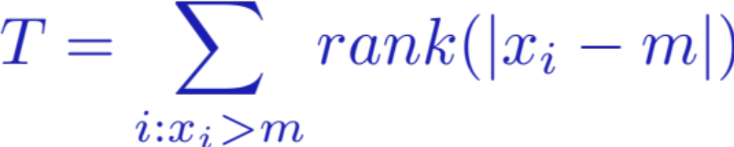
Wilcoxon Signed Rank Test
Test assumes symmetry
  Distance of values from m on lower side and on higher side
Rank all data by distance from m
  Consider sum of ranks larger than m
Wilcoxon Signed Rank test for the median:
  H₀: median = m
  H₁ median < m
    Alternatively median > m, median ≠ m
Test statistic T
Large values of T have small probability p
  Supporting the alternative hypothesis
Ideally should not have ties, otherwise corrections needed

Slide 21
Wilcoxon Signed Rank Test
Two-sample t-test: this tests whether two independent samples have the same mean (centre). It is assumed that both samples are drawn from a normal distribution.
The Wilcoxon Signed Rank Test is relevant in situations where the parent populations may be heavily skewed, or have heavy tails.
It is assumed that the two samples come from two distributions which are identical, apart from a possible shift of the central location.
The Wilcoxon Signed Rank Test tests whether the centres are identical, or one is greater than (or less than), the other.

Slide 22
Hypotheses for the Wilcoxon Signed-Rank Test
The test is based on the median, rather than the mean, with the following hypotheses:
  H₀ : median = hypothesised value
  H₁ : median ≠ hypothesised value or
  median > hypothesised value or
  median < hypothesised value

Slide 23
Algorithm
An explanation of the algorithm used for the hypothesis test, taking the following steps:
  Subtract the hypothesised median from all the values
  Arrange the resulting differences in ascending order
  Rank the absolute differences
  Calculate T₊ This is the sum of ranks of the values above the median i.e. the positive differences
  and T₋ This is the sum of ranks of the values below the median i.e. the negative differences
  If n < 15 take the smaller of T₊ and T₋ and compare to statistical tables
  If n ≥ 15 a test statistic can be calculated which is itself normally distributed

Slide 24
Example
Data | Data-median
0.6 | -0.04
0.65 | 0.01
0.58 | -0.06
0.73 | 0.09
0.71 | 0.07
0.69 | 0.05
0.63 | -0.01
0.54 | -0.1
0.70 | 0.06
0.68 | 0.04
0.74 | 0.1
0.77 | 0.13
0.73 | 0.09
0.73 | 0.09
0.74 | 0.1
0.76 | 0.12
Test H₀ : m = 0.64

Slide 25
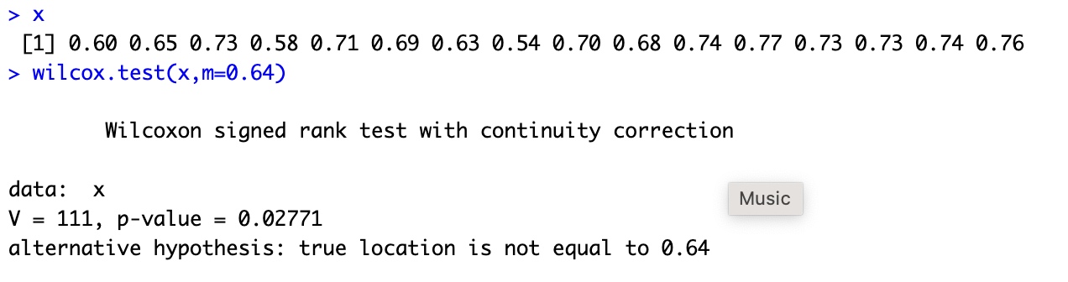
Result
The summed rank statistic must be compared to the set of all possible rank statistics for the that value of n, the number of data.
This allows a probability p to be calculated for rankings as, or more extreme than that calculated i.e. more asymmetric.
It is best to allow statistical software to do this!

Slide 26
Conclusion
First look at situations where underlying assumptions are not valid
Introduction to some non-parametric tests
  With first worked example

